Slide 1
Correcting Overfitting in Decision Trees
Bagging and Boosting ensmbles

Slide 2
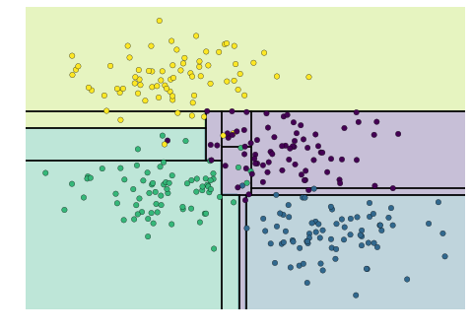
To re-cap...
Decision trees tend to overfit as tree depth increases. Notice that as the depth increases, we tend to get very strangely shaped classification regions. Here is an example with a depth of 5 (5 splits on the data)

Slide 3
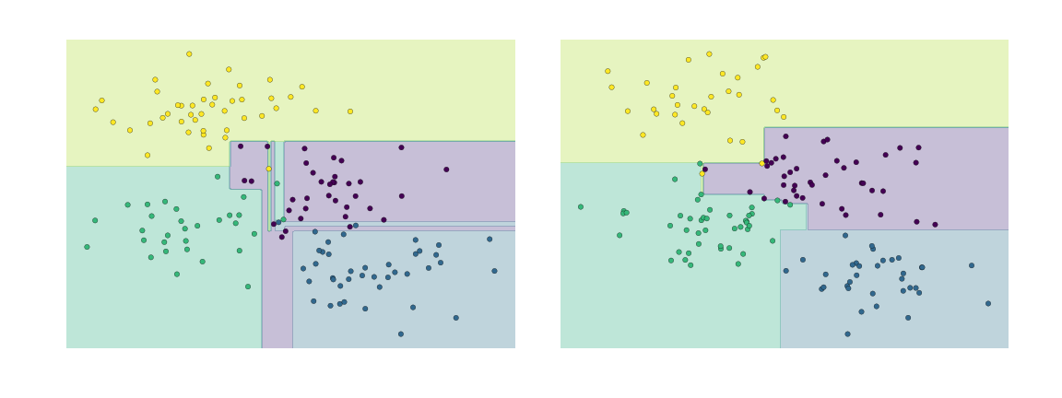
So, whats the problem?
It's clear that this overfitting is less a result of the true, intrinsic data distribution, and more a result of the particular sampling or noise properties of the data.
If we use the same data used to generate two DecisionTree models by splitting the original data in half, we get.

Slide 4
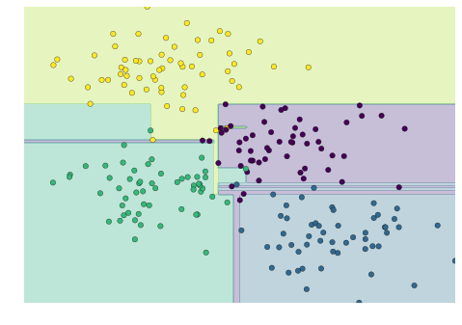
Combined Trees: A mini forest
It is clear that in some places, the two trees produce consistent results (e.g., in the four corners), while in other places, the two trees give very different classifications (e.g., in the regions between any two clusters). The inconsistencies tend to happen where the classification is less certain, and thus by using information from both of these trees, we might come up with a better result!

Slide 5
Introducing Bagging: A method that combines trees
This combination of trees is what underlies an ensemble method called bagging.
In Bagging, each of the models that over-fits the data, are averaged to result to find a better classification.
In plain bagging , each tree in the ensemble is built from a sample drawn with replacement from the training set. In addition, when splitting a node during the construction of the tree, the split that is chosen is no longer the best split among all features. (NOT Greedy!)
Instead in Random Forests the split that is picked is the best split among a random subset of the features. As a result of this randomness, the bias of the forest usually slightly increases (with respect to the bias of a single non-random tree) but, due to averaging, its variance also decreases, usually more than compensating for the increase in bias, hence yielding an overall better model.
Notes:
In other words, in building a random forest, at each split in the tree, the algorithm is not even allowed to consider a majority of the available predictors.
Suppose that there is one very strong predictor in the data set, along with a num- ber of other moderately strong predictors. Then in the collection of bagged trees, most or all of the trees will use this strong predictor in the top split

Slide 6
Random Forests Contd.
So, the primary impact of ensemble methods is to reduce variance by averaging.
In classification, this is achieved by majority voting and in regression by taking the mean or mode.
The primary method uses here is a sort of random sampling with replacement. What this means is that each tree is made of a random subset of data which is not exclusive to a tree. This uses our data well.
Now lets try a full example

Slide 7
Boosting
Suppose that there is one very strong predictor in the data set, along with a number of other moderately strong predictors. Then in the collection of bagged trees, most or all of the trees will use this strong predictor in the top split
Unlike fitting a single large decision tree to the data, which amounts to fitting the data hard and potentially overfitting, the boosting approach instead learns slowly.
Lets look at the logic of the algorithm

Slide 8
Boosting Steps
We fit a regular decision tree on our data. Then we, fit another decision tree to the residuals of the previous model.
That is, we fit a tree using the current residuals, rather than the outcome Y , as the response.
We then add this new decision tree into the fitted function in order to update the residuals.

